Slide 1



Airline Tickets

Slide 2
Team
20191700103 إسراء محمد عبدالحميد محمد
20191700717 نورهان ماهر عبدالفتاح عطيه
20191700340 عبدالرحمن عاطف رشدان ابراهيم
20191700727 هاجر يحي حسين علي
20191700312 شروق وجيه عيد محمد

Slide 3
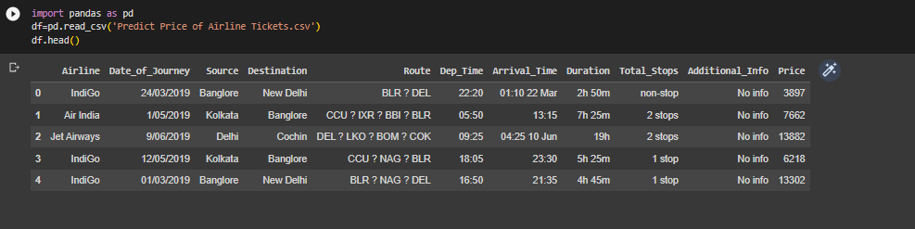
description
This Project includes information about a Airline Tickets (Airline, Date of Journey, Source, Destination, Route, departure Time, Arrival Time, Duration, Total Stops, Additional Info, Price)

Slide 4
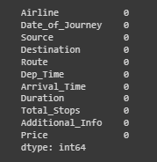
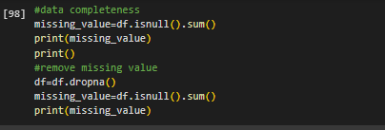
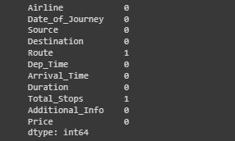
data wrangling
Cleaning Data
After Remove Null
Removing Missing Values

Slide 5
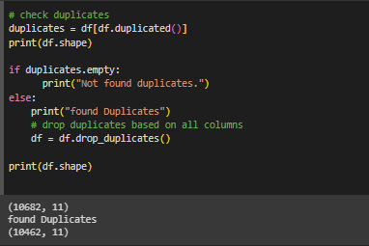
data wrangling
2. Removing duplicates

Slide 6
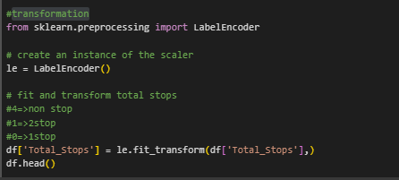
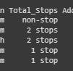
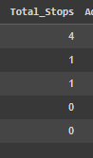
data wrangling
3. Encoding

Slide 7
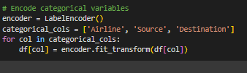
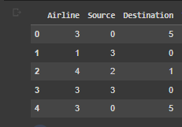
data wrangling
3. Encoding cont…

Slide 8
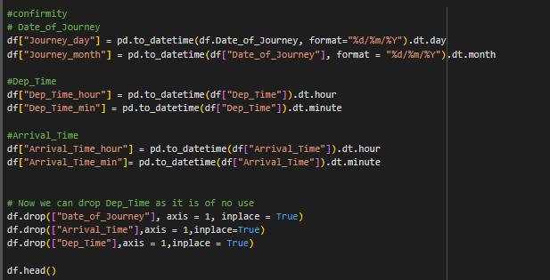
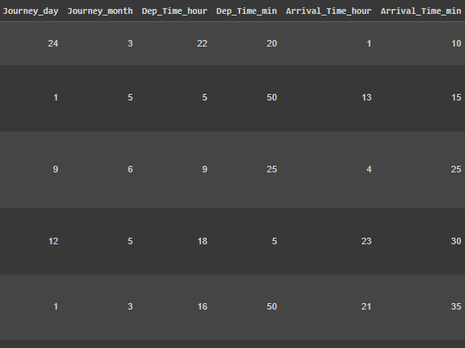
data wrangling
4. Data Validation: Conformity

Slide 9
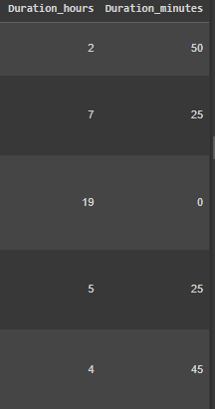
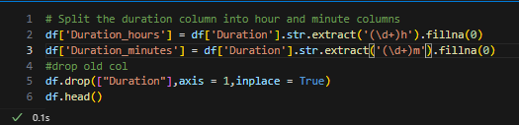
data wrangling
4. Conformity cont…

Slide 10
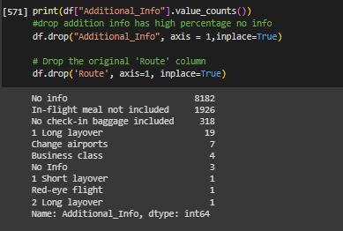
data wrangling
5. Drop unimportant columns

Slide 11
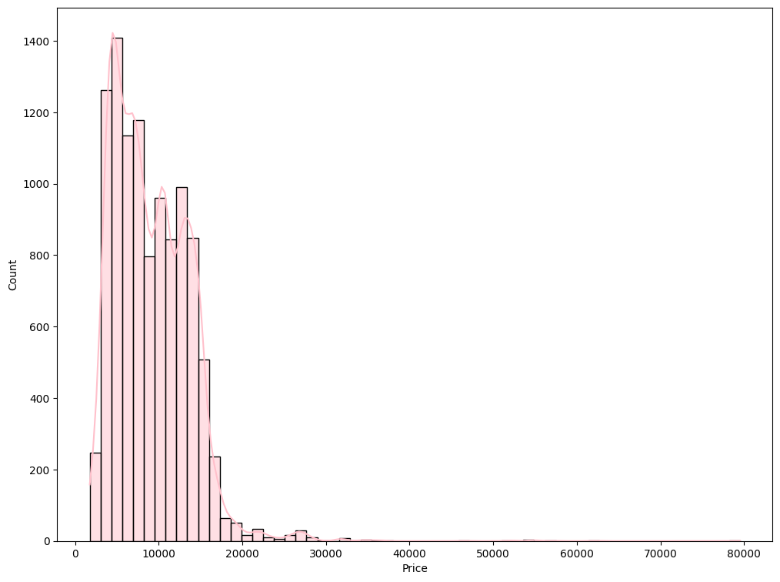
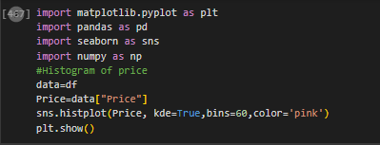
virtualization
1. Histogram

Slide 12
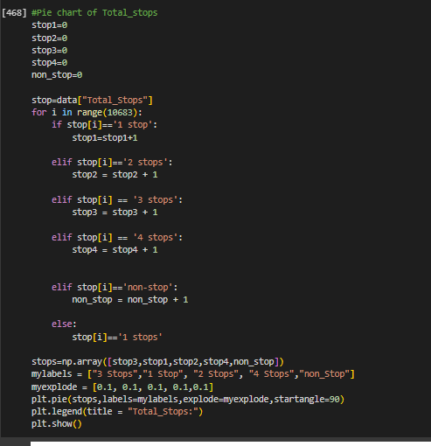
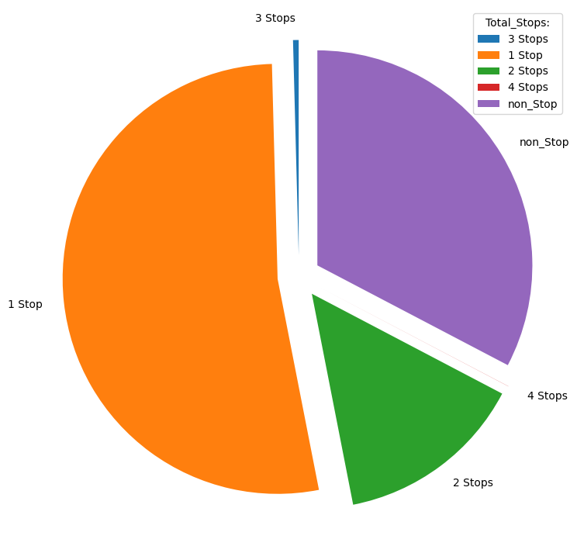
virtualization
2. Pie Chart

Slide 13
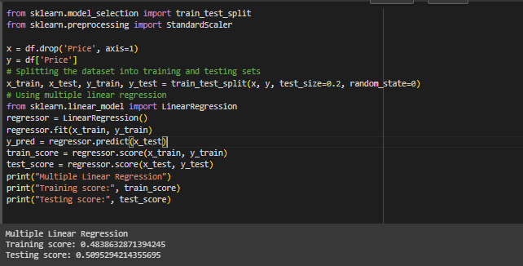
apply Regression Algorithm Using Multiple Linear Regression

Slide 14
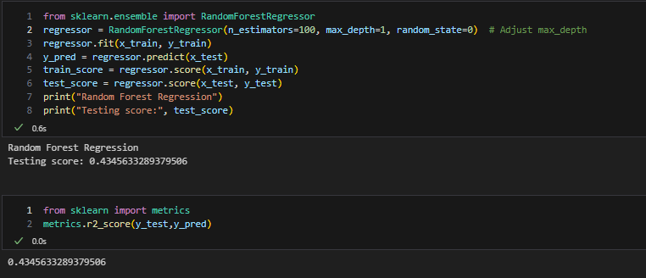
apply Regression Algorithm Using Random Forest Regressor
Before Tune model parameters

Slide 15
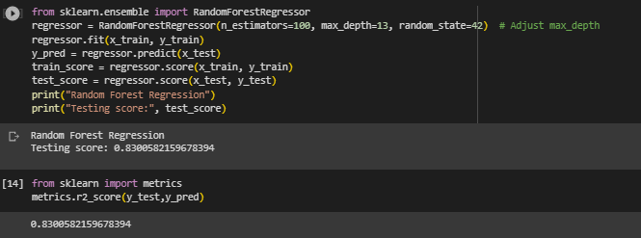
apply Regression Algorithm Using Random Forest Regressor
After Tune model parameters

Slide 16
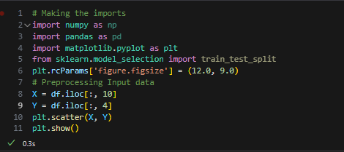
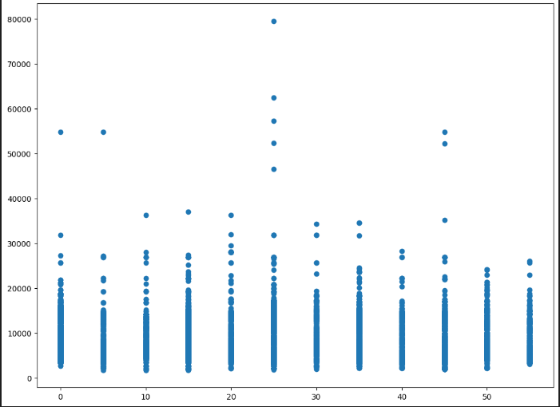
Tune model parameters to get high accuracy

Slide 17
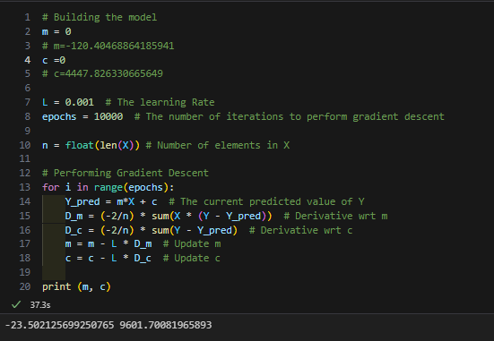
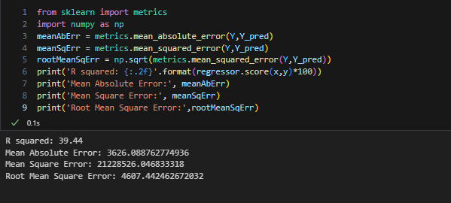
Tune model parameters to get high accuracy
Before Tune model parameters

Slide 18
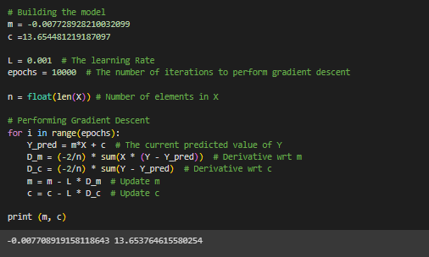
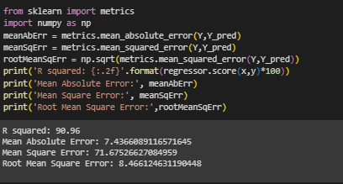
Tune model parameters to get high accuracy
After Tune model parameters

Slide 19
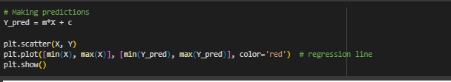
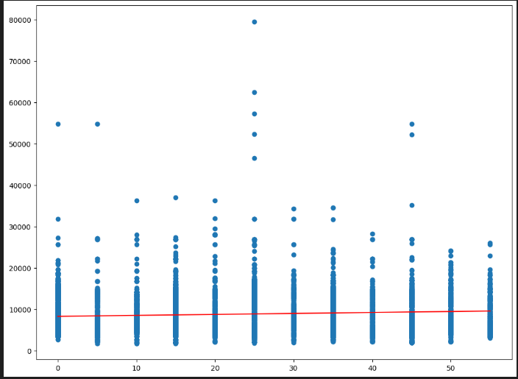
Tune model parameters to get high accuracy

Slide 20
Thanks

